Slide 1

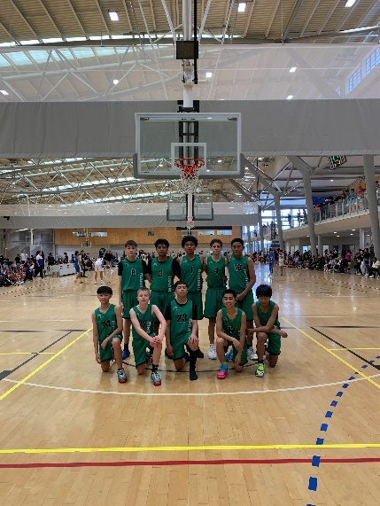
Representative Program 2026

Slide 2

Basketball Manawatū Representative Season
Overview
Preparation
Training Schedule
Training Dates
Training Times
Training Venues
Tournaments

Slide 3
Basketball Manawatū Age Groups Structure:
U20 Premier Men & U20 Premier Women
U18 Premier
Men
U16 Premier Men & Women
U18 Development A Team
U16 Development A Team
Development Green

Slide 4

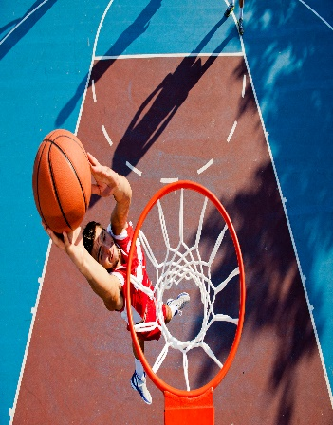

U20 Program
29 May – 01 June
Foot Locker Nationals
Porirua
Training Schedule
14 Weeks
1 x 1.5-hour sessions
Wed Term 1
Sunday Term 2
Training Dates
As per attached schedule
Tournaments
Qualifying Dates
06 February
Palmerston North
07 February
Hawera
Notes:
No training Easter Break
No training April School holidays
BM U20 Premier

Slide 5



U18 Program
08 - 11 July
BBNZ Footlocker Nationals
Papakura
Pulman Centre
Training Schedule
17 weeks
1 x 1.5-hour sessions
Wed Term 1
Sun Term 2
Training Dates
See attached training schedule
Tournaments
Regional qualifying 30 May – 01 June
Palmerston North
Notes:
No Easter Break training
No April school holiday training
No training King’s Birthday
BM U18 Premier

Slide 6

U16 Premier
15 – 18 July
BBNZ Footlocker Nationals
Christchurch
Training Schedule
1 x 1.5-hour sessions
Training Dates
See attached training schedule
Tournaments
Regional qualifying 30 May – 01 June
Palmerston North
Notes:
No training Easter Break
No training April school holidays
No training King’s Birthday
BM U16 Premier

Slide 7
U18
Development Team
Training Schedule
1 x 1.5-hour sessions
Training Dates
As per attached training schedule
Tournaments
Regional qualifying 30 May – 01 June
Palmerston North
Notes:
No training Easter Break
No training April holidays
Final key event King’s Birthday regional tournament
BM U18 Development

Slide 8
U16
A Team
Development Green
Training Schedule
1 x 1.5-hour sessions
Training Dates;
As per attached training scheduled
Tournaments
Regional qualifying 30 May – 01 June
Palmerston North
Notes:
No training Easter Break
No training April school holidays
BM U16 Development:

Slide 9
Training Schedule U20
Start Date: 28 Jan 6pm – 7.30pm
04 Feb,11, 18 & 25 Feb
04 March, 11, & 18
No training 25 March
01st April
Wednesdays
Training Resumes: 26 April
Venue & Time TBC
Sunday Sessions
Training Schedule U18
Start Date: 28 Jan 4pm – 6pm
04 Feb,11, 18 & 25 Feb
04 March, 11, & 18
No training 25 March
01st April
Wednesdays
Training Resumes: 26 April
Venue & Time TBC
Sunday Sessions
Training Schedule U16
Start Date: 28 Jan 4pm – 6pm
04 Feb,11, 18 & 25 Feb
04 March, 11, & 18
No training 25 March
01st April
Wednesdays
Training Resumes: 26 April
Venue & Time TBC
Sunday Sessions

